Slide 1

CS1231S Discrete Structures
AY2022/23 Semester 1

Slide 2
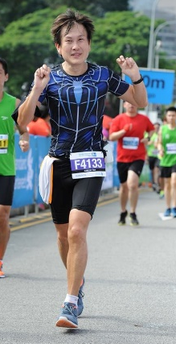
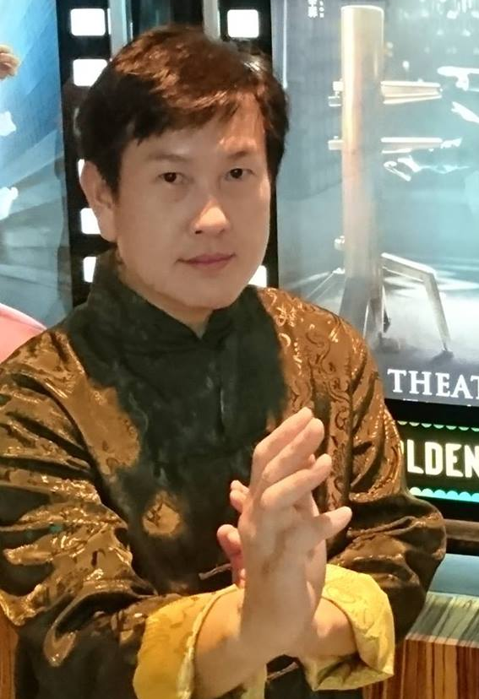
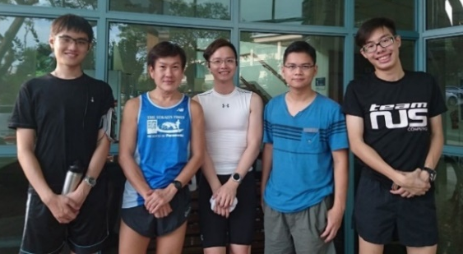
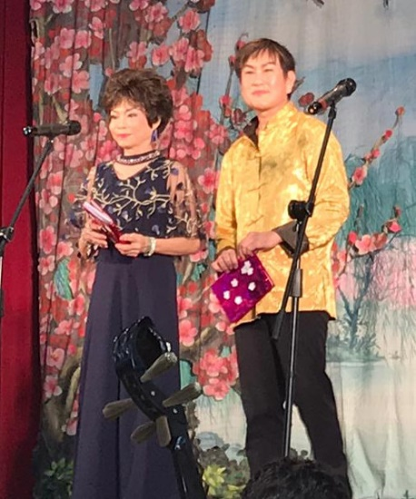
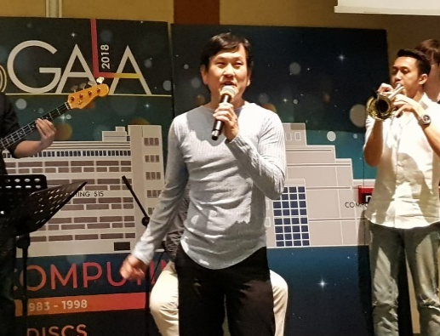
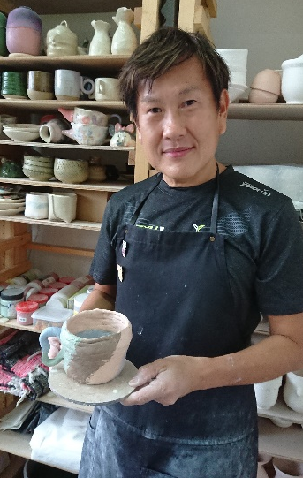
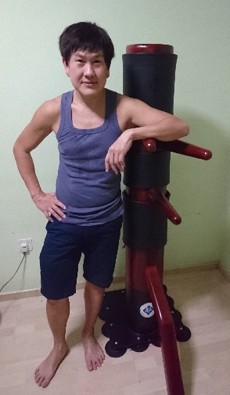
Welcome to CS1231S
1. Lecturers
Cantonese opera
Running
Used to have weekly runs with students every week (pre-Covid days)
A/P Tan Tuck Choy, Aaron
Office: COM1-03-12
Email: tantc@comp.nus.edu.sg
Singing
Pottery
Wing Chun
Admin appointment:
Assistant Dean (Undergraduate Studies)
SoC Gala Dinner 2018

Slide 3
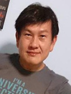
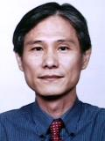
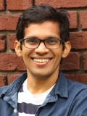





























Welcome to CS1231S
1. Tutors (https://www.comp.nus.edu.sg/~cs1231s/1_module_info/staff.html)
Aaron Tan
A/P Leong
Dr Ashish
Enzio
Sherman
Aaron Li
Andrew
Bharath
Chayapol
Yanyu
Yui To
Jeng Yee
Jing Quan
Daryl
Simpson
Siau Chiak
Ryan
Jayanth
Jerald
Anh Duc
Ngoc Long
Bryce
Devansh
Bing Chieh
Yuan Wei
Jun JIe
Theodore
Tingjia
Wrik
Jiaxin
Yu-Cheng
Zhou Qi

Slide 4
Welcome to CS1231S
2. Objectives
To develop mathematical maturity – the ability to formalize concepts, work from definitions, think rigorously, reason concisely, and construct a theory.
To provide basic mathematical prerequisites relevant to Computer Science.

Slide 5
Welcome to CS1231S
3. Topics
Topics include:
Propositional logic and predicate logic
Proof techniques
Sets
Relations
Mathematical Induction
Functions
Cardinality
Counting and Probability
Graphs and Trees

Slide 6
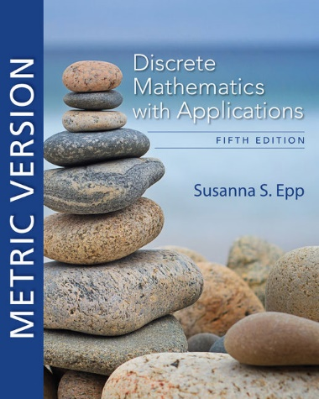
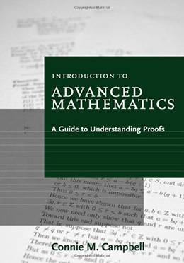
Welcome to CS1231S
4. Reference Books
Discrete Mathematics with Applications
5th Edition
Author: Susanna S. Epp
Publisher: Cengage Asia
ISBN-13: 9780357114087 ISBN-10: 0357114086 Online resource
Introduction to Advanced Mathematics:
A Guide to Understanding Proofs
Author: Connie M. Campbell Publisher: Cengage Asia ISBN-13: 9780547165387 ISBN-10: 0547165382
It’s ok if you get the 4th edition.

Slide 7
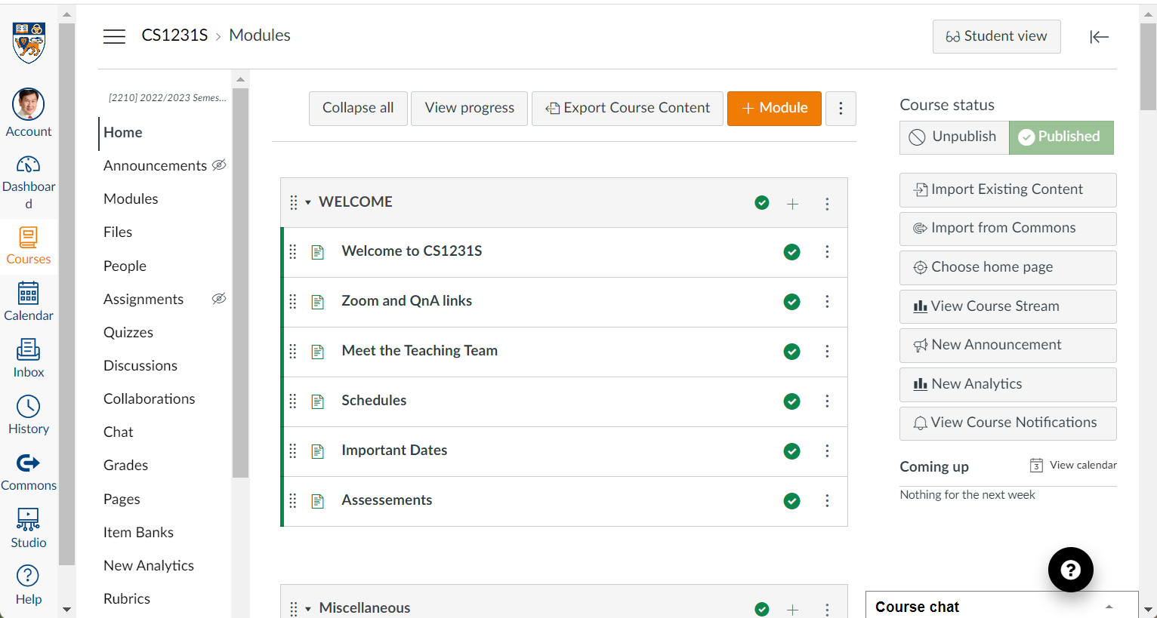
Welcome to CS1231S
5. Online Resources (1/2)
Canvas: https://canvas.nus.edu.sg

Slide 8
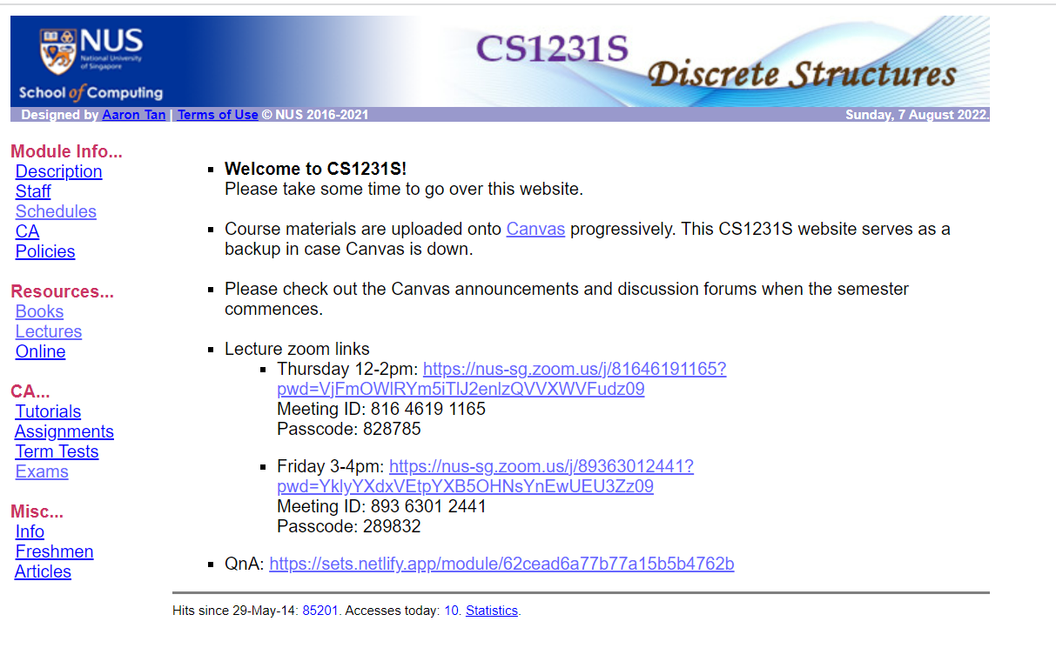
Welcome to CS1231S
5. Online Resources (2/2)
CS1231S module website: https://www.comp.nus.edu.sg/~cs1231s
As backup in case Canvas is down.

Slide 9
Welcome to CS1231S
6. Assessments
CA component | Date | Weightage
Tutorial attendance | - | 5%
Two assignments | Due: weeks 6 & 12 | 20%
Midterm test | 5 Oct (Wed) 6:30-8:30pm | 25%
Final exam | 24 Nov (Thu) 1-3pm | 50%
Midterm test and final exam are open book and face-to-face. More details will be given out later.
Please post on “Canvas > Discussions > Midterm Test” by 22 Aug if the CS1231S midterm test clashes with your other test. Please provide details (such as the other module code and timing).

Slide 10
Welcome to CS1231S
7. Lecture Plan (See CS1231S website for latest updates)
https://www.comp.nus.edu.sg/~cs1231s/1_module_info/sched.html
Week | Lecture topics
1 | Speaking Mathematically; The Logic of Compound Statements
2 | The Logic of Quantified Statements
3 | Methods of Proofs
4 | Sets
5 | Relations
6 | Modular Arithmetic and Partial Orders
Recess
7 | Mathematical Induction and Recursion
8 | Functions
9 | Cardinality
10 | Counting and Probability
11 | Counting and Probability (cont’d); Graphs
12 | Graphs (cont’d); Trees
13 | Filler
Lectures are online, recorded over Zoom, and published on Canvas.

Slide 11
Welcome to CS1231S
8. Tutorial Schedule (Refer to ModReg site)
Tutorials start in week 3 (22 August) and are face-to-face.
See tutorial schedule as at 7 August (as mentioned, this is dynamic and subject to changes) on the following CS1231S web page: https://www.comp.nus.edu.sg/~cs1231s/1_module_info/sched.html or refer to ModReg or NUSMODS for the most up-to-date information.
Please do NOT email us (acad staff) on requests such as adding you to a group or moving you to a different group. We are not permitted to do this. All requests/appeals should be sent to the ModReg where dedicated admin staff will handle and process your requests. Sending your requests to us will just cause further delay as we could at most forward your request to the admin.
I will be monitoring the situation on my side and will post updates via Canvas announcements.

Slide 12
Welcome to CS1231S
9. Blended Learning
CS1231S has been selected to go Blended Learning mode.
However, as the enrolment for CS1231S is too big, we can’t implement recitation classes as a replacement for lectures, hence we will retain the lectures, but introduce some elements of Blended Learning.
Students are to view the lecture slides and previous semester’s lecture recordings before the lecture.
Students are to post questions on the topics to be discussed in the coming week.
The process will evolve over time as we experiment.

Slide 13
Welcome to CS1231S
10. Why is Discrete Mathematics Important?
Discrete Math (DM) is important, especially for Computer Science.
Every field in CS is related to discrete objects – databases, neural networks, automata, etc.
It is the backbone of CS.
Concepts and notations from DM are useful in studying the describing objects and problems in all branches of CS, such as algorithms, programming languages, theorem proving and software development
Modeling with DM is an extremely important problem solving skill.
Useful for algorithms modules:
CS2040 (Data Structures and Algorithms), CS3230 (Design and Analysis of Algorithms), etc.
Logic part is useful in CS2100 (Computer Organisation).

Slide 14
Welcome to CS1231S
11. Plagiarism
Use or close imitation of the language and thoughts of another author and the representation of them as one’s own original work.
Plagiarism by students, professors, or researchers is considered academic dishonesty or academic fraud, and offenders are subject to academic censure, up to and including expulsion.
Do not plagiarise or commit any acts of dishonesty.
Further information:
https://www.comp.nus.edu.sg/cug/plagiarism/
http://nus.edu.sg/celc/programmes/plagiarism.html

Slide 15



Welcome to CS1231S
12. CS1231S Tagline

Slide 16
What have you heard about CS1231S from those who have taken it before?
Challenging
Boring
Interesting
Killer module
Prepare to S/U
Depressing
I can do it!
Heard nothing

Slide 17
END OF FILE

